Slide 1


Notes on Interpreting Networks
In collaboration with James Glazier, Bloomington

Slide 2
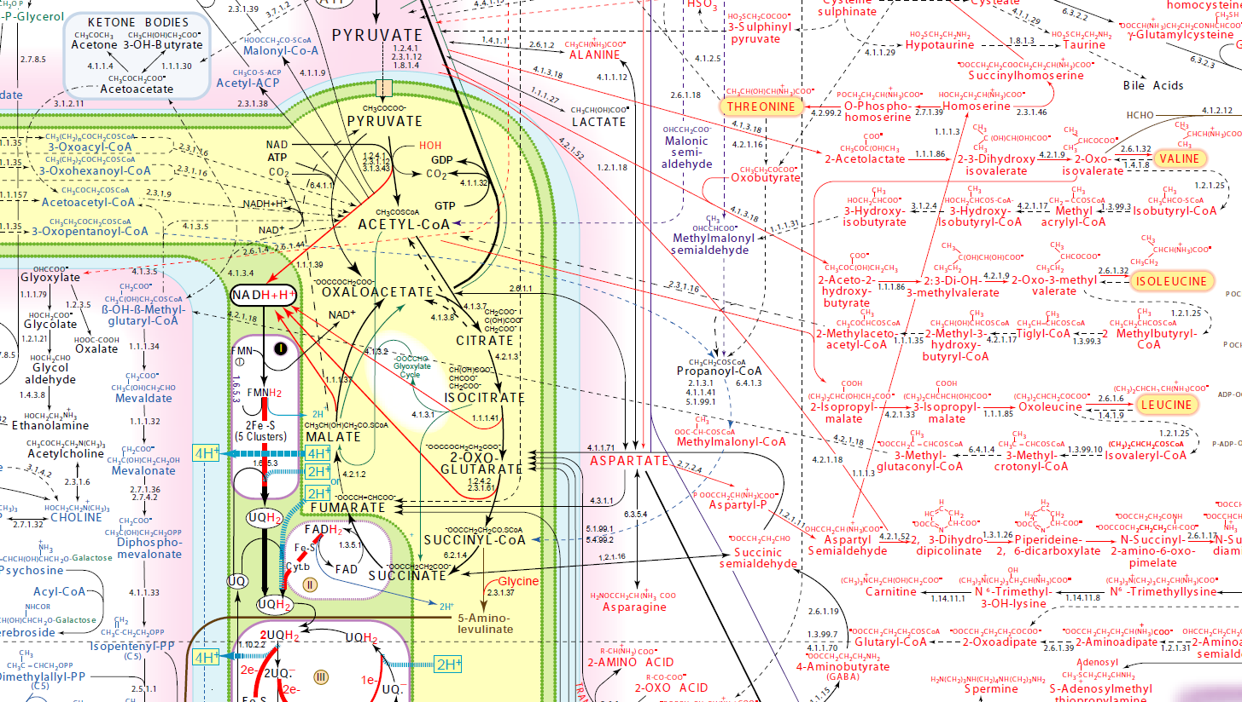
Metabolic Networks
http://www.iubmb-nicholson.org/chart.html

Slide 3
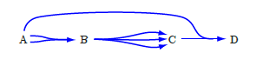

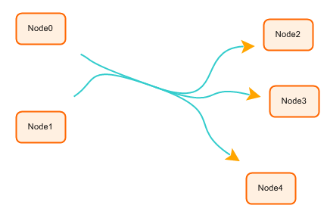
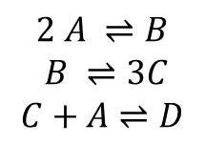
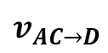
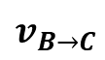
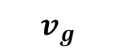
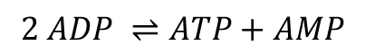
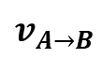
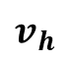
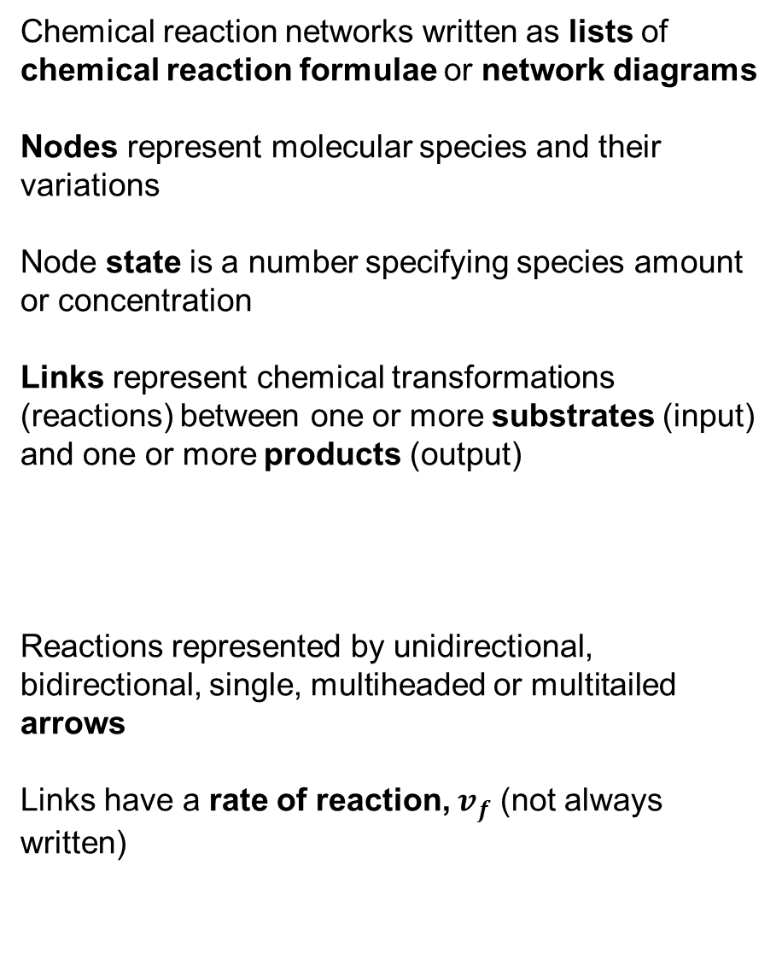
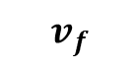
Chemical Reaction Networks—Representation
Chemical reaction networks written as lists of chemical reaction formulae or network diagrams
Nodes represent molecular species and their variations
Node state is a number specifying species amount or concentration
Links represent chemical transformations (reactions) between one or more substrates (input) and one or more products (output)
Reactions represented by unidirectional, bidirectional, single, multiheaded or multitailed arrows
Links have a rate of reaction, $v_{f}$ (not always written)
Chemical Reaction Formula
$$2 ADP ⇌ATP+AMP$$
Chemical Reaction Formula
$$2 A ⇌B$$
$$B ⇌3C$$
$$C+A⇌D$$
Chemical Reaction Diagram
$$v_{A→B}$$
$$v_{B→C}$$
$$v_{AC→D}$$
$$v_{f}$$
$$v_{h}$$
$$v_{g}$$
Chemical reaction networks conserve mass
Real metabolic reaction rates are often faster than other network-modeled processes in cells

Slide 4
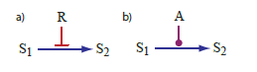
Chemical Reaction Networks—Catalysts
Catalysts are molecules that affect (usually increase) the rate of a chemical reaction, but do not react themselves, so the rate law depends on the amount of catalyst present
$$v_{h}\left(S1,A\right)$$

Slide 5
Protein Signaling Networks—Representation
Nodes in a signaling network can represent molecular species or complex behaviors. Node states are usually numbers representing the amount or concentration of a species or the level of activity of a behavior
Links come in two basic categories, reaction links between nodes identical to those in chemical reactions, which represent transformations of molecular species (again, possibly multi-headed or multi-tailed) and links between nodes and chemical reaction links which represent regulation
A regulatory link indicates that the rate of the reaction link depends on the concentration or amount in the source node
In general, chemical reaction links use up their substrates, while regulatory links do not
Regulatory links may be activating (excitatory), in which case a larger amount of the species at the node increases the rate of the reaction or the level of the response
Regulatory links may be inhibiting, in which case a larger amount of the species at the node decreases the rate of the reaction or the level of the response

Slide 6
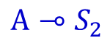
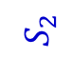
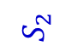
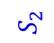
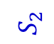
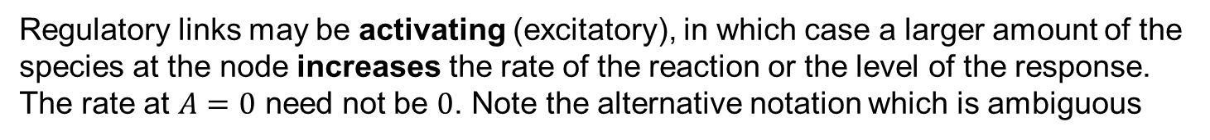
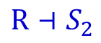
Regulatory Links—Interpretation
A regulatory link indicates that the rate of the reaction link depends on the concentration or amount in the source node
Regulatory links may be activating (excitatory), in which case a larger amount of the species at the node increases the rate of the reaction or the level of the response. The rate at $A=0$ need not be $0$. Note the alternative notation which is ambiguous
$$S_{2}$$
$$S_{2}$$
$$A⊸S_{2}$$
A
A
Regulatory links may be inhibiting, in which case a larger amount of the species at the node decreases the rate of the reaction or the level of the response. Note the alternative notation which is ambiguous
$$S_{2}$$
$$R⊣S_{2}$$
$$S_{2}$$
R
R

Slide 7
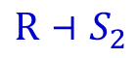

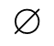
Translating Signaling Arrows into Chemical Reactions
To simulate these signaling networks in Tellurium we will have to understand how they map onto chemical reaction networks
When we see the diagram
We interpret it as the extended chemical reaction
Which is really the chemical reaction in standard notation
The symbol indicates that we are not keeping track of the material used up in the reaction
$$$$
P1
$$A⊸S_{2}$$
$$$$
$$$$
$$v_{1}(A)$$
P1
$$S_{1}$$
$$v_{1}(A)$$
P1
$$R⊣S_{2}$$
$$$$
$$$$
$$v_{1}(R)$$
P1
$$S_{1}$$
$$v_{1}(R)$$

Slide 8
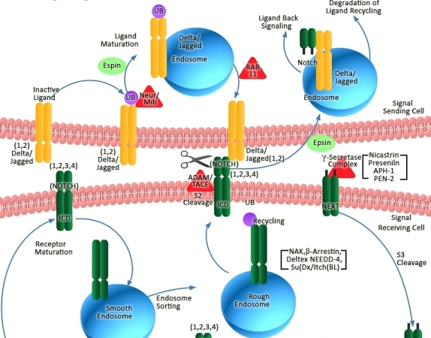
Protein Signaling Networks—Spatial Aspects
Signaling networks have complex spatial relationships between components, e.g. the initial signal may result from binding of an extracellular molecule to a transmembrane receptor (often a receptor tyrosine kinase or G-Protein coupled receptor) and these receptors may associate in complex spatial relationships with each other and with macromolecular and protein components like the cytoskeleton and downstream kinases, signal processing may occur in the cytoplasm but act in the nucleus or in a narrow subvolume of the cytoplasm or on a highly structured macromolecular machine like the actin cytoskeleton
Most signaling network models neglect this spatial structure

Slide 9
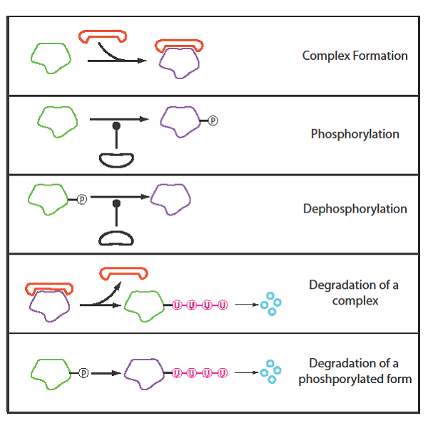
Signaling Networks Basic Mechanisms
Signaling networks employ a number of regulatory mechanisms (complexing, phosphorylation, ubiquitination) to control the flow of molecules and information
Classic examples include:
Enzyme with a phosphate group attached is active, enzyme without phosphate is inactive (or vice versa)
Attachment of an ubiquitin tail leads to enzyme degradation
Many proteins have multiple phosphorylation sites (up to 20), whose detailed function not well understood
Kinase
Phosphatase

Slide 10
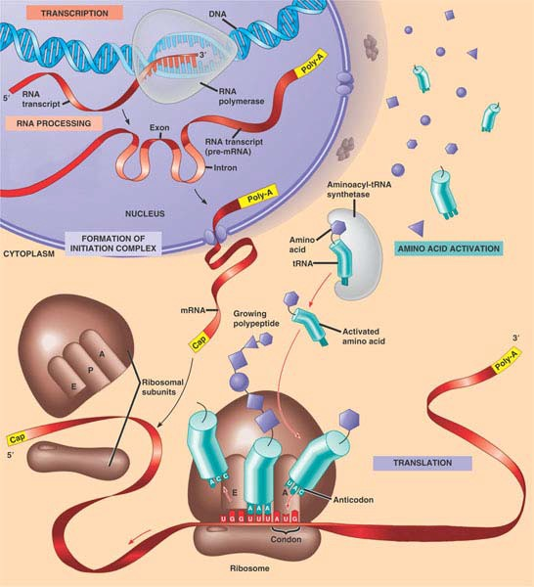
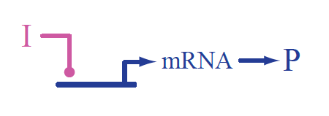
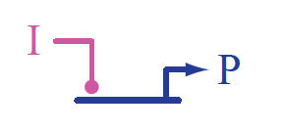
Gene Regulatory Networks—Notation
Models (and graphical notation) for GRNs focus on the transcription factors, RNAs and other molecules that turn genes on and off by binding to the DNA
Gene P
Binding of an Inducer I to the DNA for Gene P produces mRNA, which is translated into protein P. Neglects editing, transport and post-translational steps
https://www.thinglink.com/scene/616264922585628674
Gene P
Binding of an Inducer I to the DNA for Gene P produces protein P. Neglects translation, editing, transport and post-translational steps
Based on biotapestry standard http://www.biotapestry.org/

Slide 11
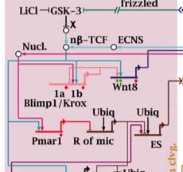
Gene Regulatory Networks—Types of Nodes and Links
The nodes of a gene regulatory network come in multiple categories
Names next to horizontal lines with arrows represent genes and their molecular species (DNA, RNA, proteins) they produce directly or indirectly by transcription, translation, etc…
Floating names, represent molecular species which affect transcription, translation, etc… (DNA, RNA, small molecules,…)
The state of a named node is an amount or concentration or a Boolean Yes/No
http://scienceblogs.com/pharyngula/2006/06/modules_and_the_promise_of_the.php
Links come in multiple categories and represent regulation and rates of transcription, translation, degradation, formation of complexes, modification,…
Notation is awkward because a gene node also functions as a link between regulator and molecular output
GRNs make something out of nothing (we don’t model where the components to make the RNA or protein come from) or the additional factors needed for transcription, not the many other types of regulation determining transcription and translation rates

Slide 12
Gene Regulatory Networks—Complexity
Despite the complexity of the diagrams, GRNs still leave out a lot (for many questions these omissions won’t matter much):
Collective effects in regulation of transcription. Many molecular species act together to turn genes on or off
Regulation of transcription at the level of DNA methylation and chromatin remodeling (by acetylation or methylation of histones and more obscure mechanisms)
Small numbers of copies of key transcription factors and of mRNAs mean that rates of protein production fluctuate a lot
Stochasticity of binding, activation, transcription,…
Regulation at translational and other levels
Regulatory systems differ in bacteria and eukaryotes
Spatial relationships
Transport between regions of the cell
Time delays
http://scienceblogs.com/pharyngula/2006/06/modules_and_the_promise_of_the.php

Slide 13
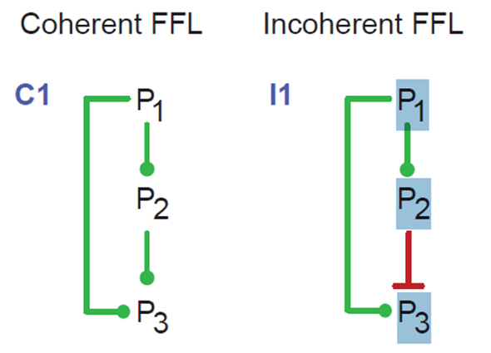
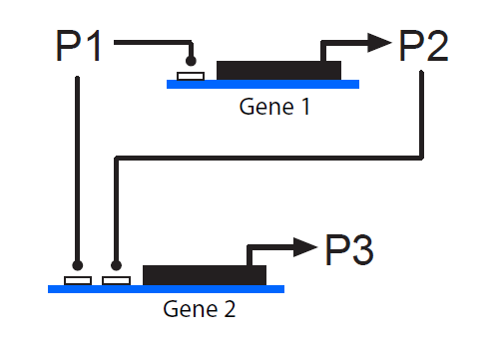
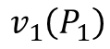
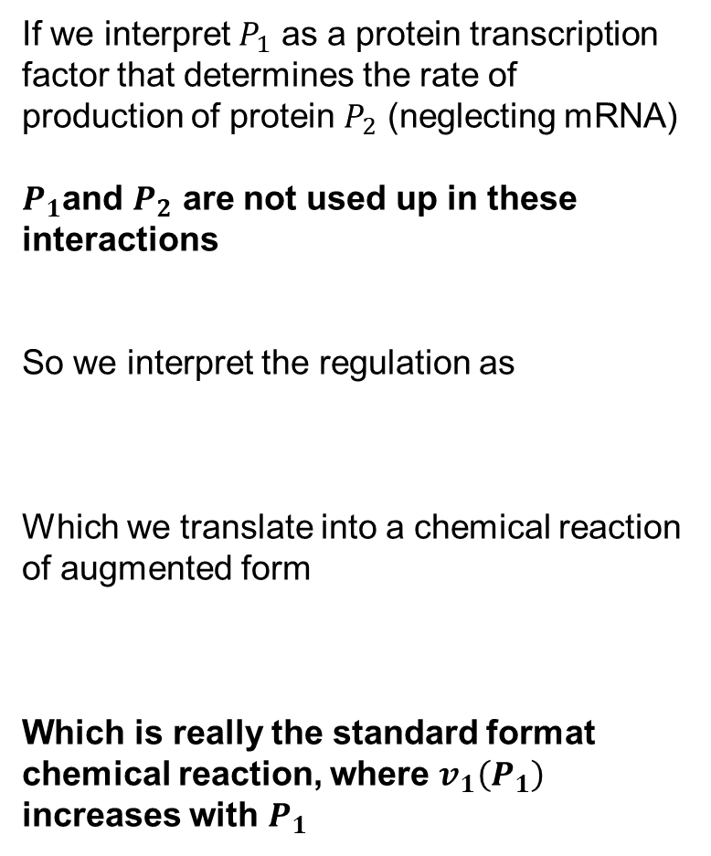
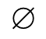
Interpreting Gene Regulatory Networks into Chemical Reactions
If we interpret $P_{1}$ as a protein transcription factor that determines the rate of production of protein $P_{2}$ (neglecting mRNA)
$P_{1}$and $P_{2}$ are not used up in these interactions
So we interpret the regulation as
Which we translate into a chemical reaction of augmented form
Which is really the standard format chemical reaction, where $v_{1}\left(P_{1}\right)$ increases with $P_{1}$
$$P_{1}$$
$$P_{2}$$
$$P_{1}$$
$$$$
$$P_{2}$$
$$v_{1}\left(P_{1}\right)$$
P1
$$$$
$$P_{2}$$
$$v_{1}\left(P_{1}\right)$$

Slide 14
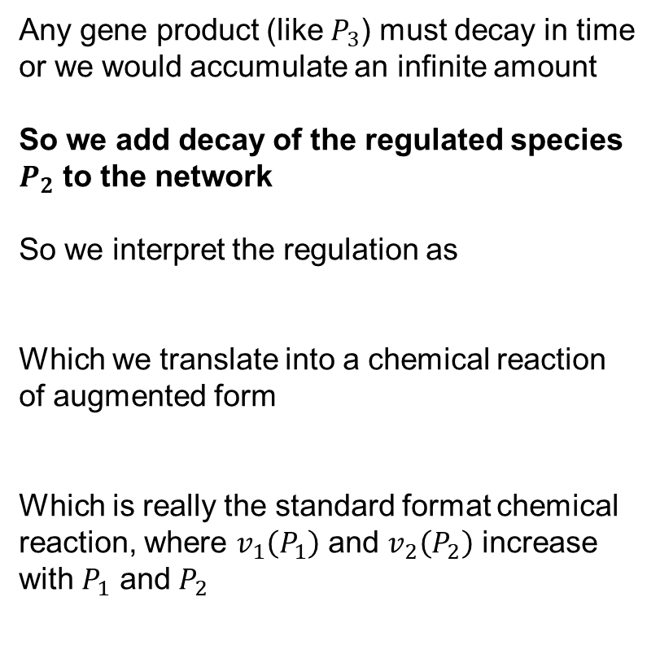
Gene Regulatory Networks: Decay
Any gene product (like $P_{3}$) must decay in time or we would accumulate an infinite amount
So we add decay of the regulated species $P_{2}$ to the network
So we interpret the regulation as
Which we translate into a chemical reaction of augmented form
Which is really the standard format chemical reaction, where $v_{1}\left(P_{1}\right)$ and $v_{2}\left(P_{2}\right)$ increase with $P_{1}$ and $P_{2}$
$$P_{1}$$
$$P_{2}$$
$$$$
$$P_{1}$$
$$$$
$$P_{2}$$
$$$$
$$v_{1}\left(P_{1}\right)$$
$$v_{2}\left(P_{2}\right)$$
$$$$
$$P_{2}$$
$$$$
$$v_{1}\left(P_{1}\right)$$
$$v_{2}\left(P_{2}\right)$$

Slide 15
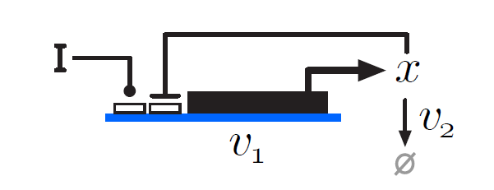
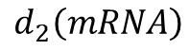
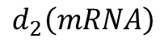
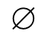
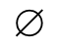
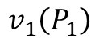
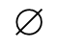
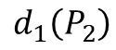
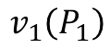
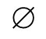
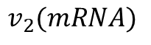
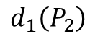
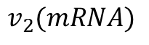
Gene Regulatory Networks: Including Translation
Sometimes the extra step of translation of mRNA into protein is regulated or the time delay associated with it is critical, in this case, we need to extend our interpretation to include the production, translation and degradation of mRNA
So simple arrow becomes 4 reactions with 4 rate laws!
$$P_{1}$$
$$P_{2}$$
$$d_{1}$$
$$P_{1}$$
mRNA
$$P_{2}$$
$$d_{2}$$
$$v_{2}$$
$$d_{1}$$
$$v_{3}$$
$$P_{1}$$
mRNA
$$$$
mRNA
$$$$
$$$$
$$P_{2}$$
$$$$
$$v_{1}\left(P_{1}\right)$$
$$d_{2}\left(mRNA\right)$$
$$v_{2}(mRNA)$$
$$d_{1}\left(P_{2}\right)$$
P1
mRN
$$$$
mRNA
$$$$
$$$$
$$P_{2}$$
$$$$
$$v_{1}\left(P_{1}\right)$$
$$d_{2}\left(mRNA\right)$$
$$v_{2}(mRNA)$$
$$d_{1}\left(P_{2}\right)$$

Slide 16
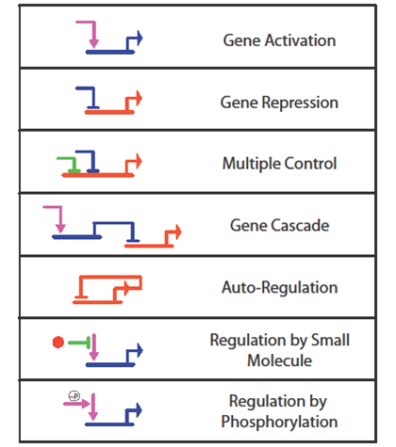
Gene Regulatory Networks—Motifs
Certain regulatory network structures (motifs) occur frequently and have (relatively) predictable effects
Cell differentiation states in early development of sea urchins
Often genes are either on (transcribed at a standard rate) or off (transcribed at a very low rate) so network behavior is approximately boolean
Time scales are often slower than for signaling and metabolic networks

Slide 17
Sources for Network Structures
KEGG http://www.genome.jp/kegg/
Database of hypothesized metabolic, signaling and gene regulatory network stuctures in humans and animal species
STRING http://string.embl.de/
Database of protein-protein interactions in a variety of species
EcoCyc http://ecocyc.org/
For E. coli bacteria—includes a complete web-runnable model of E. coli metabolism
RegulonDB http://regulondb.ccg.unam.mx/
For E. coli bacteria—includes detailed models of E. coli gene regulation
BioModels Database https://www.ebi.ac.uk/biomodels-main/ Database of executable SBML models of biological networks

